Slide 1
Lecture#8
Clustering-1
Age
Income

Slide 2
Objective
to learn what clustering is
to learn some common clustering techniques

Slide 3
Definition
: an unsupervised – learning used in data mining to explore the understanding of a smaller group of data
  - It is rarely used alone but rather a preprocessing step of other data mining techniques.

Slide 4
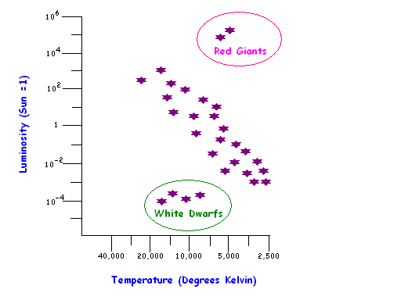
Clustering example -- Science
Main Sequence
Figure 10.1 The Hertzsprung-Russell diagram clusters stars by temperature and luminosity

Slide 5
Clustering example - Marketing
Retired people
Age
Executives
Teenagers
Income

Slide 6
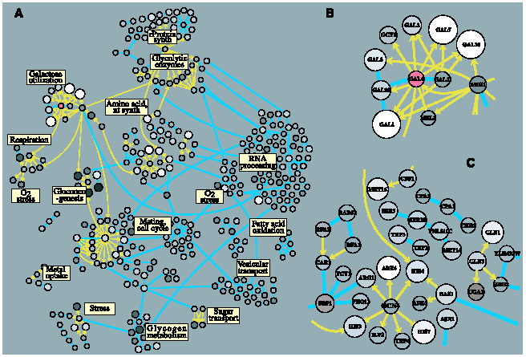
Clustering example - Bioinformatics
Ex clustering of genes, source: [2]

Slide 7
The K-means method
a most commonly used method
input variables must be in numerical form
use the concept of “distance” in assigning each record to the nearest cluster center
in real application, there could be very high number of variables or “dimentions”

Slide 8
Ex K- Mean Clustering (K=2)
Phase 3 | Normalized Age | Normalized Salary
Case1 | 3 | 5
Case2 | 6 | 10
Case3 | 4 | 3
Case4 | 8 | 9
Salary
2 4 6 8 10 Age

Slide 9
Ex K- Mean Clustering (K=2) … Cont.
Initial condition: choose k cases randomly as initial k cluster centers.
Stopping condition: cluster number of all cases in the current phase are the same as all cluster numbers in the previous phase.
Phase 1 | Normalized Age | Normalized Salary | d(X, Center1) | d(X, Center2) | Assign to Cluster#
Center1 | 3 | 5
Center2 | 6 | 10
Case1 | 3 | 5 | 0 | Sqrt(9+25) | 1
Case2 | 6 | 10 | Sqrt(9+25) | 0 | 2
Case3 | 4 | 3 | Sqrt(1+4) | Sqrt(4+49) | 1
Case4 | 8 | 9 | Sqrt(25+16) | Sqrt(4+1) | 2

Slide 10
Ex K- Mean Clustering (K=2) … Cont.
Before continue : recalculate all cluster centers by computing the average the values of each attribute from all cases in the same cluster.
Phase 2 | Normalized Age | Normalized Salary | d(X, Center1) | d(X, Center2) | Assign to Cluster#
Center1 | 3.5 | 4
Center2 | 7 | 9.5
Case1 | 3 | 5 | Sqrt(0.25+1) | Sqrt(16+4.5*4.5) | 1
Case2 | 6 | 10 | Sqrt(6.25+36) | Sqrt(1+0.25) | 2
Case3 | 4 | 3 | Sqrt(0.25+1) | Sqrt(9+6.5*6.5) | 1
Case4 | 8 | 9 | Sqrt(4.5*4.5+25) | Sqrt(1+0.25) | 2

Slide 11
Ex K- Mean Clustering (K=2) … Cont.
Before continue : Stopping condition is true → Finish !!!
Phase 3 | Normalized Age | Normalized Salary | Assign to Cluster#
Center1 | 3.5 | 4
Center2 | 7 | 9.5
Case1 | 3 | 5 | 1
Case2 | 6 | 10 | 2
Case3 | 4 | 3 | 1
Case4 | 8 | 9 | 2
ANSWER

Slide 12
Ex K- Mean Clustering (K=2) … Result
Normalized Salary
Cluster2
10
8
6
4
2
Cluster1
2 4 6 8 10 Normalized Age

Slide 13
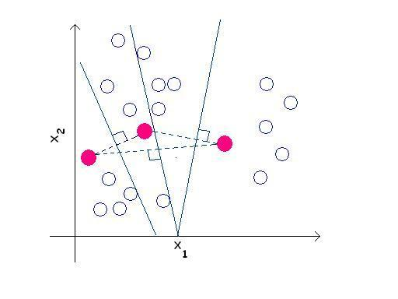
Seed 2
Seed 3
Seed 1
Figure 10.3 The initial seeds determine the initial cluster boundaries

Slide 14
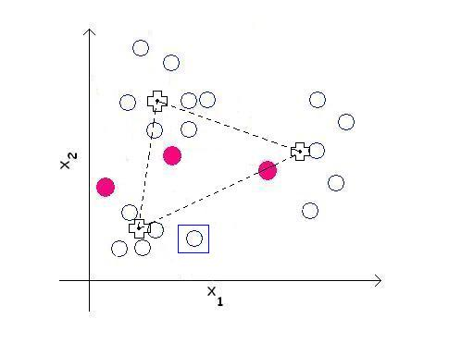
Figure 10.4 Calculating the centroids of the new clusters

Slide 15
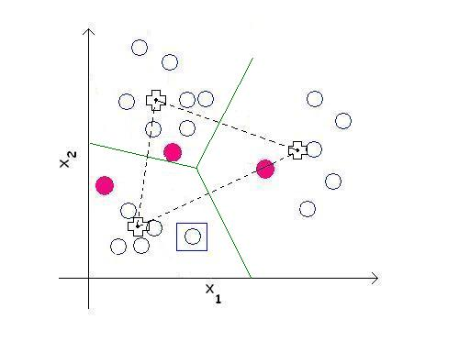
Figure 10.5 At each iteration, all cluster assignments are re-evaluated

Slide 16
Common problems
What value of “K” should we start with?
What if we have several types of variables in clustering?

Slide 17
Variable/ attribute/ feature types
Category OK to say X≠Y but not X>Y or Y>X
Rank can put things in order but can not tell the degree of difference
Interval OK to order and find degree of difference
True measures interval variables from a meaningful zero points

Slide 18
Weight
not all variables are equally important
clustering credit card customers – the similar monthly balance is more important than the number of cards each customer has
clustering home owners – the number of children each family has is more important than the area of the house
Normally, each variable are weighted equally and sumed to 1.0

Slide 19
Scaling / Normalization
: remapping the value of a variable into either 0 to 1 or -1 to 1. This is done to reduce the bias in different unit of measurements
Common practice
  Divide each variable by its mean
  Divide each variable by the range after subtract the lowest value
  Z – score conversion (subtract X with mean and divide by s.d.)

Slide 20
Variations on the K-mean Method
Alternate choosing the initial seeds
Alternate methods of computing the next centroid
Using probability density rather than distance

Slide 21
Agglomerative / Hierarchical methods
- Unlike k-mean with a starting K, this method start by merging each data point to the next similar points to form a gradual bigger cluster until all points become one single cluster

Slide 22
Ex Hierarchical clustering of 7 data points – step1

Slide 23
Ex Hierarchical clustering of 7 data points- step2

Slide 24
Ex Hierarchical clustering of 7 data points-step3

Slide 25
Ex Hierarchical clustering of 7 data points-step4

Slide 26
Ex Hierarchical clustering of 7 data points-step5

Slide 27
Ex Hierarchical clustering of 7 data points – step6

Slide 28
Ex Hierarchical clustering of 7 data points – step 8

Slide 29
Algorithm of Agglomerative
Create a similarity matrix
( size = n² ; n = number of data points)
Find smallest value in similarity matrix then merge these two data points into a new cluster
Update the similarity matrix of the new cluster
Repeat step 2-3 until get only one cluster

Slide 30
Ex Agglomerative method (Hierarchical )
Step0: n=4, d(x, y) ← Euclidean
 | Age | Salary
X1 | 3 | 5
X2 | 6 | 10
X3 | 4 | 3
X4 | 8 | 9
d(x, y) | X1 | X2 | X3 | X4
X1 | 0 | Sqrt (9+25) | Sqrt (1+4) | Sqrt(25+16)
X2 | Sqrt (9+25) | 0 | Sqrt(4+49) | Sqrt(4+1)
X3 | Sqrt (1+4) | Sqrt(4+49) | 0 | Sqrt(16+36)
X4 | Sqrt(25+16) | Sqrt(4+1) | Sqrt(16+36) | 0
Step1: merge(X1, X3)
or merge(x2, x4). In this case, we choose the first option.

Slide 31
Ex Agglomerative method (Hierarchical ) … cont.
 | Age | Salary
X1’ | 3.5 | 4
X2 | 6 | 10
X4 | 8 | 9
d(x, y) | X1 | X2 | X4
X1 | 0 | Sqrt (6.25+36) | Sqrt(20.25+25)
X2 | Sqrt (6.25+36) | 0 | Sqrt(4+1)
X4 | Sqrt(20.25+25) | Sqrt(4+1) | 0
Step2: merge(X2, X4)

Slide 32
Ex Agglomerative method (Hierarchical ) … cont.
 | Age | Salary
X1’ | 3.5 | 4
X2’ | 7 | 9.5
d(x, y) | X1’ | X2’
X1’ | 0 | Sqrt (12.25+30.25)
X2’ | Sqrt (12.25+30.25) | 0
Step3: Only one option here, merge(X1’, X2’)

Slide 33
Ex Agglomerative method (Hierarchical ) … cont.
 | Age | Salary
X’ | 10.5/4 | 13.5/4
Step4: Only one cluster left. → Done…!!
ANSWER
X1 X3 X2 X4

Slide 34
Evaluating Clusters
maximize Inter – cluster varience
( inside cluster)
minimize Intra – cluster varience
( outside cluster)

Slide 35
Other clustering method
Self organizing maps (SOM)
(This will be covered in details later in Neural Network)
Conceptual clustering
Etc.

Slide 36
Advantages of clustering
undirect knowledge discovery
technique
work with all kinds of data
(categorical, numeric, textual data)
easy to apply

Slide 37
Disadvantages of clustering
choosing the right distance measures, weights, and the number of clusters can be difficult.
sensitivity to initial parameters
result can be hard to interpret

Slide 38
References
Berry, M., and Linoff, G., “Data Mining Techniques for Marketing, Sales, and Customer Support”, John Wiley & Sons, 1997.
Ideker, T., Thorsson, V., Ranish, J., Christmas, R., Buhler, J., Eng, J., Bumgarner, R., Goodlett, D., Aebersold, R., and Hood, L., “Integrated Genomic and Proteomic Analyses of a systematically Perturbeb Metabolic Network”, page 929 – 934, 4 May 2001, Vol.292 science, www.sciencemag.org

